Slide 1
Lesson 6
Sensors in Remote Sensing ( Contd)
( Lidar and Microwave sensors)

Slide 2
An active optical remote sensing instrument
Non-imaging instrument
Instruments sends several pulses on ground and receive it in time
domain.

Slide 3
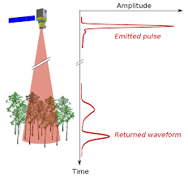
Each time the laser is pulsed:
Laser generates an optical pulse
Pulse is reflected off an object and returns
to the system receiver
Time measurement is converted to a distance (the distance to the target and the
position of the airplane is then used to determine
the elevation and location)
Multiple returns can be measured for each pulse
Up to 200,000+ pulses/second

Slide 4
ACTIVE SENSOR: LIDAR
LIDAR
Distance = (Speed of Light x Time of Flight) / 2
https://www.earthdatascience.org/courses/use-data-open-source-python/data-stories/what-is-lidar-data/

Slide 5
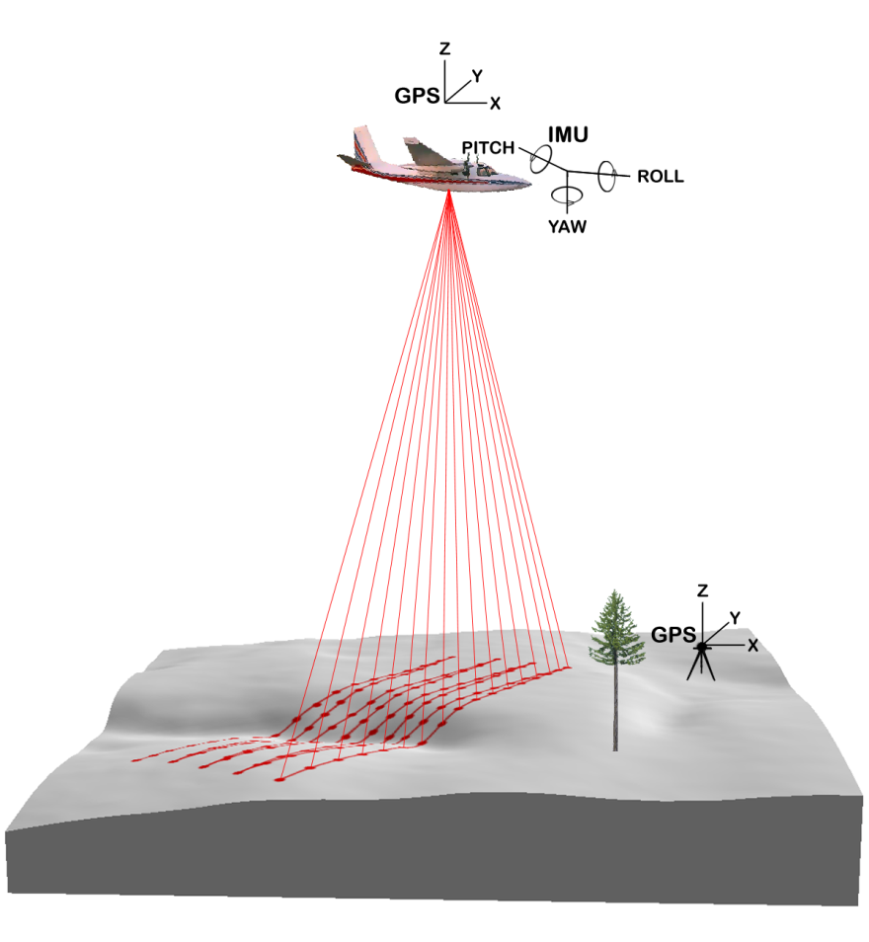
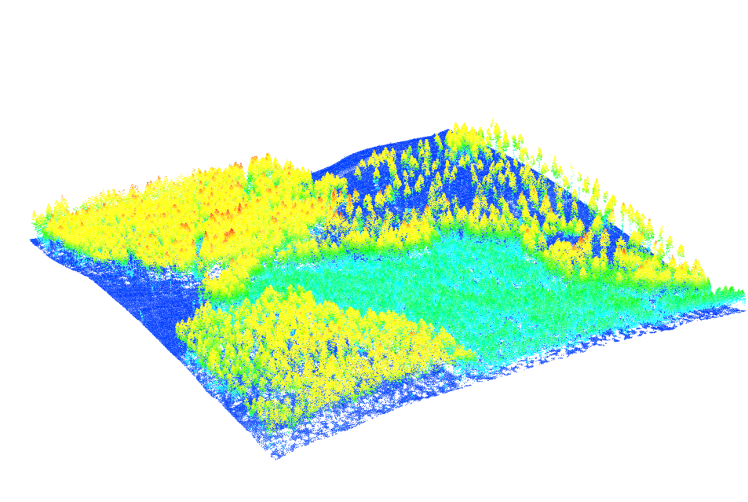
Aerial LiDAR System Components*
Aircraft
Scanning laser emitter-receiver unit
Differentially-corrected GPS
Computer
LiDAR point data colored by height
*components can be sources of error…more on this in Part II
Figures from McMcGaughey
USDA Forest Service--PNW Research Station

Slide 6
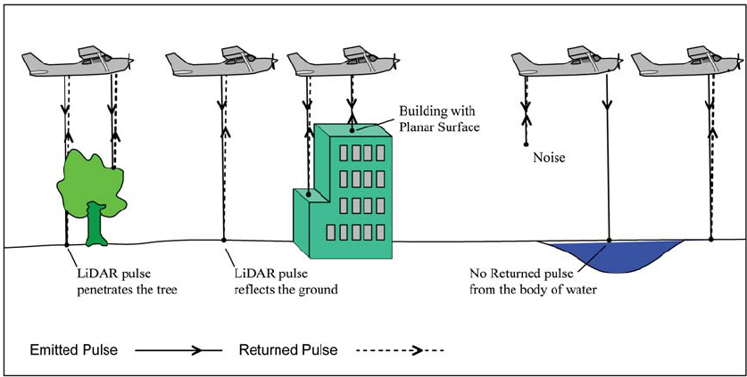
Distance = (Speed of Light x Time of Flight) / 2

Slide 7
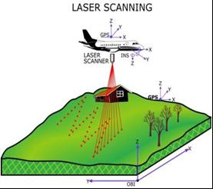
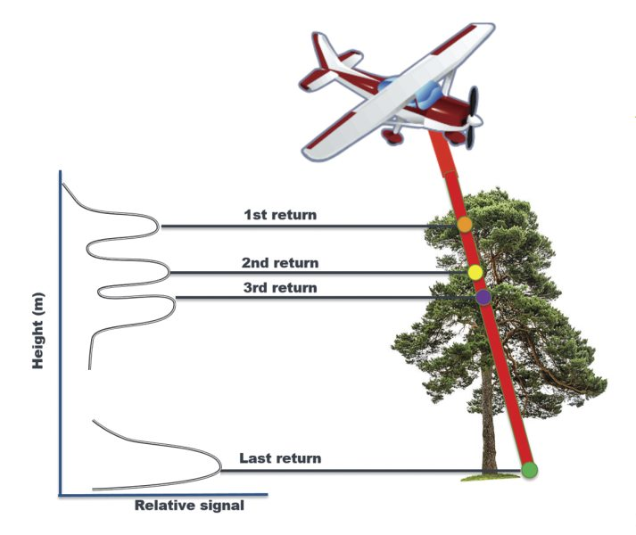

Slide 8


Slide 9
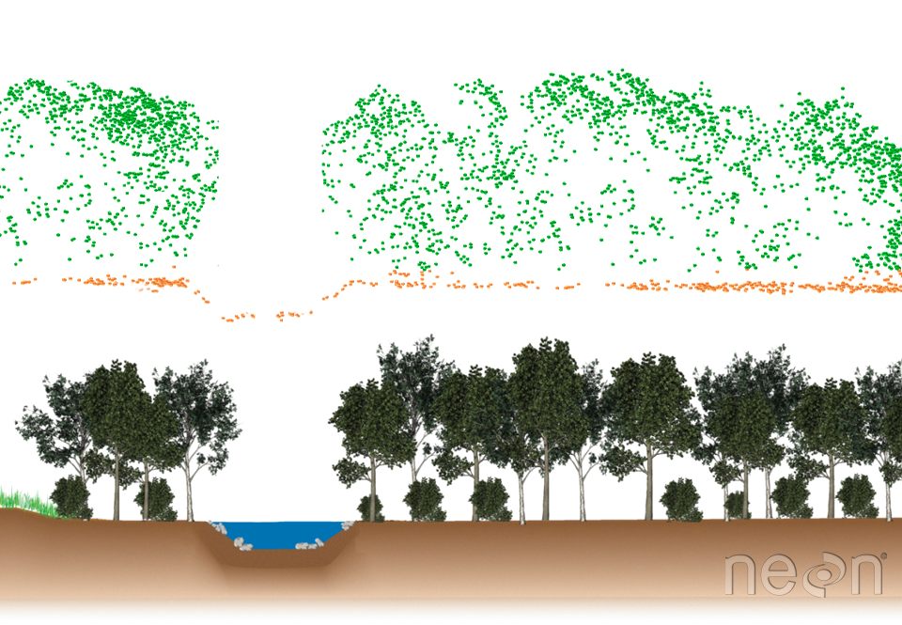
TREE STRUCTURE

Slide 10
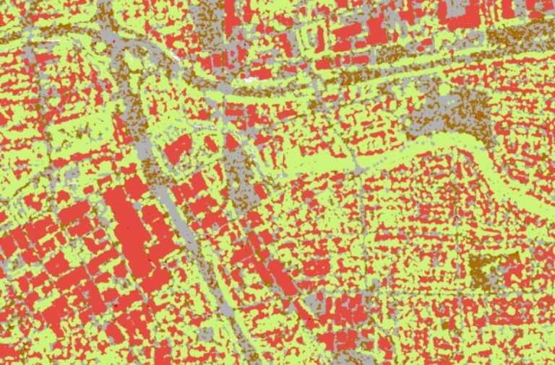
LIDAR APPLICATIONS
tree structure and height
digital elevation models.
Land cover
topographic contours,i

Slide 11
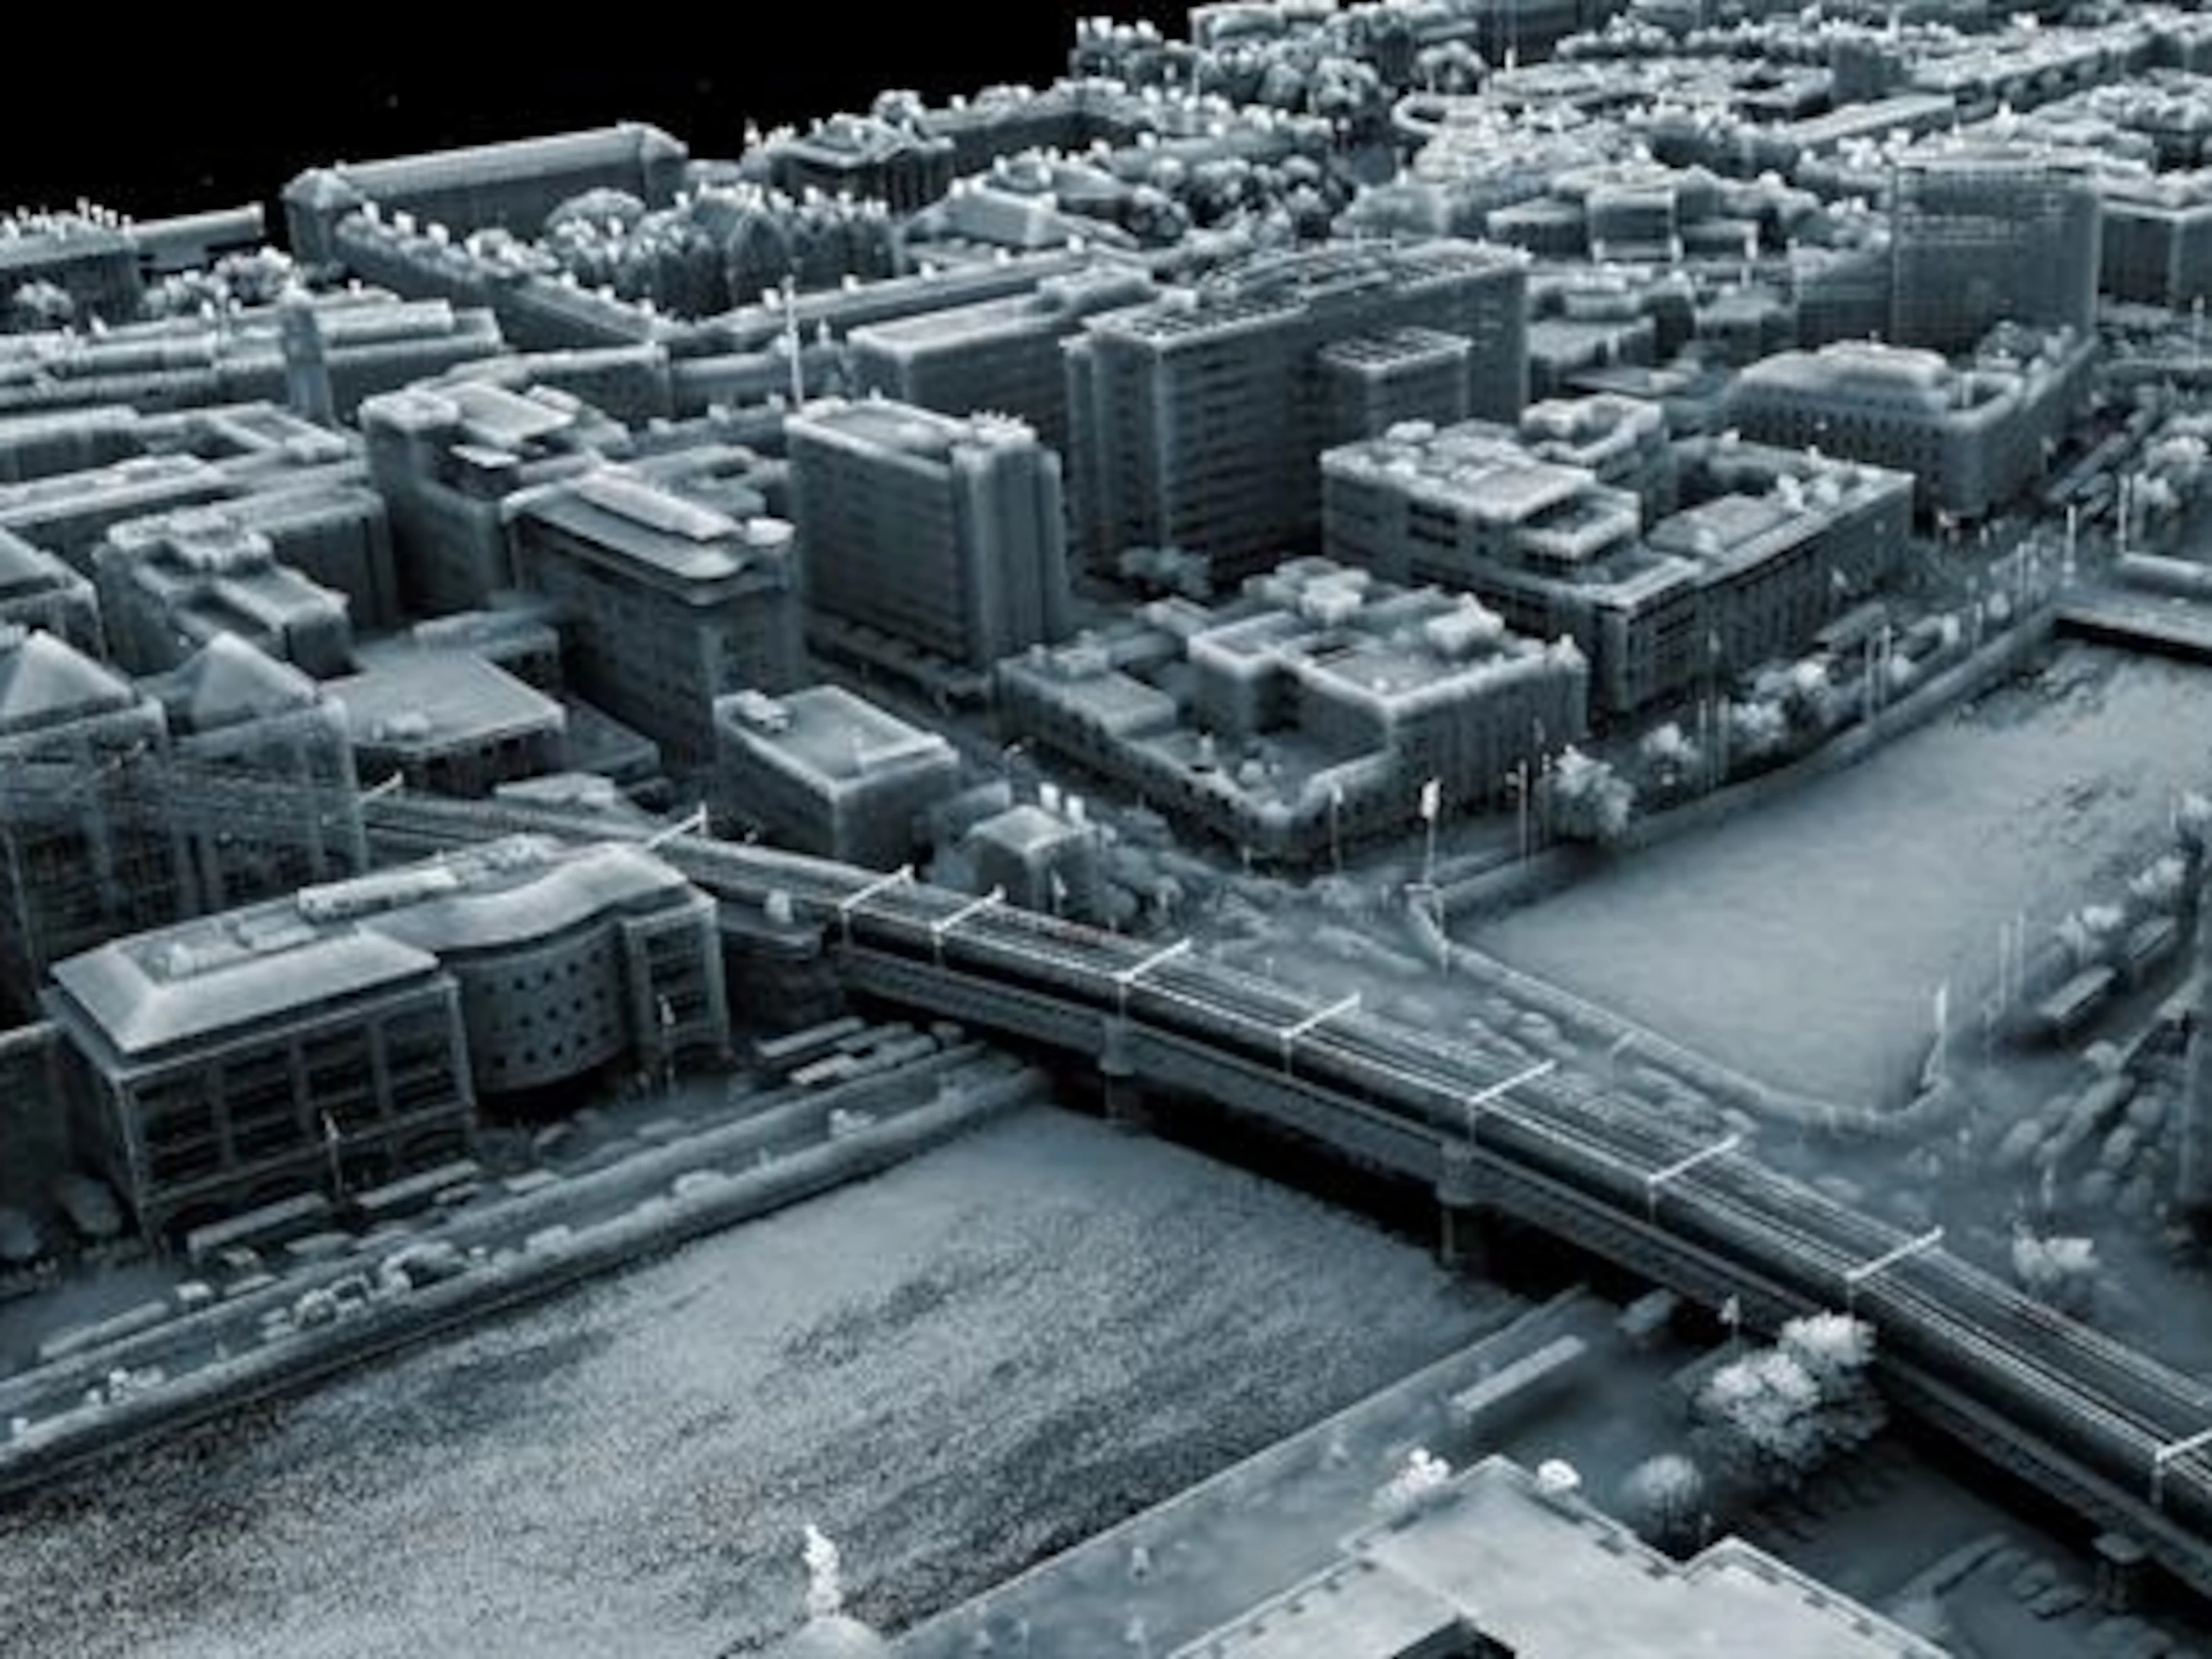

Slide 12
Atmospheric gases ( industrial poluutants So2, No2,etc) , aerosol, land surface

Slide 13
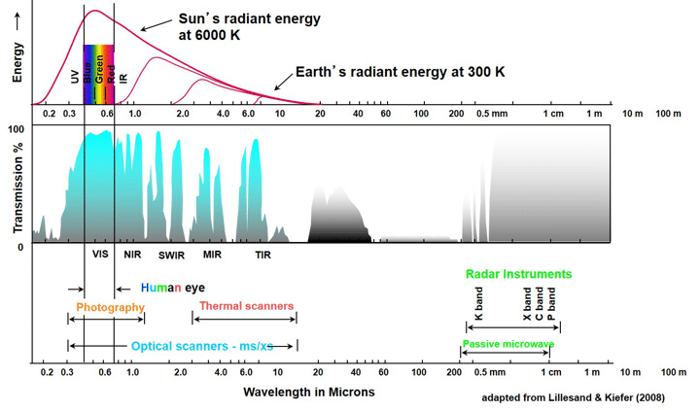

Slide 14
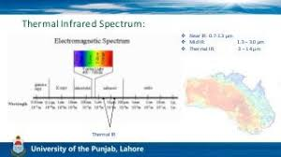

Slide 15
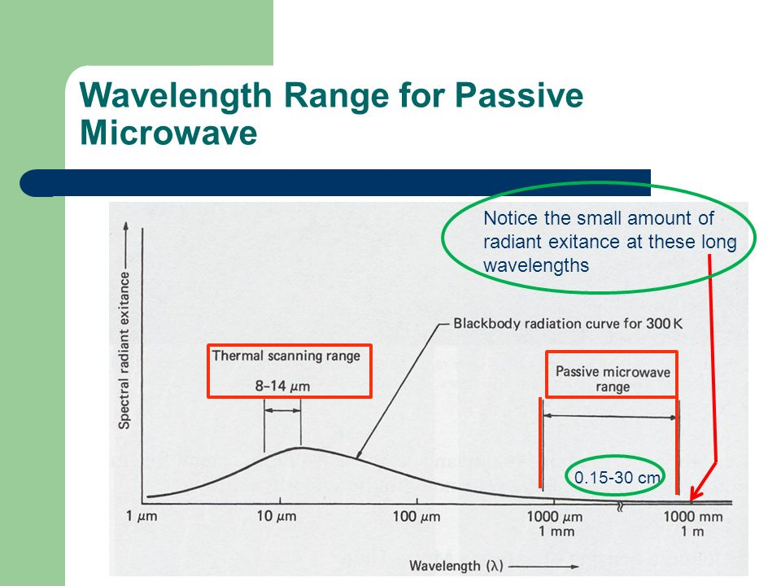

Slide 16
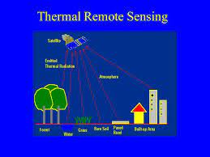
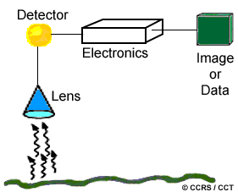
A bolometer is a device for measuring radiant heat by means of a material having a temperature-dependent electrical resistance
It absorbs radiation by which its temp increases

Slide 17
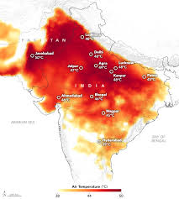
Heat wave

Slide 18
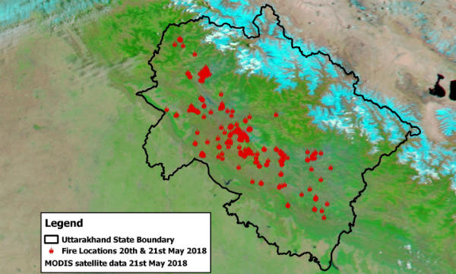

Slide 19
MICROWAVE SENSORS

Slide 20
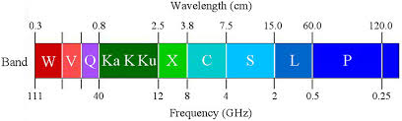

Slide 21
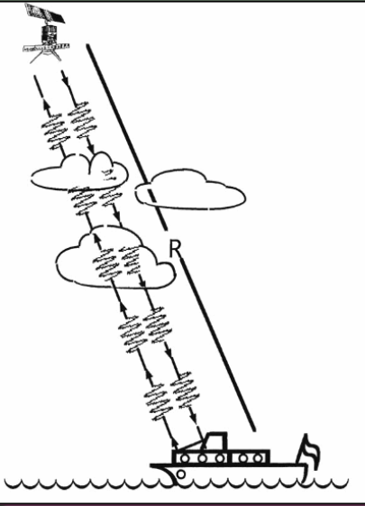
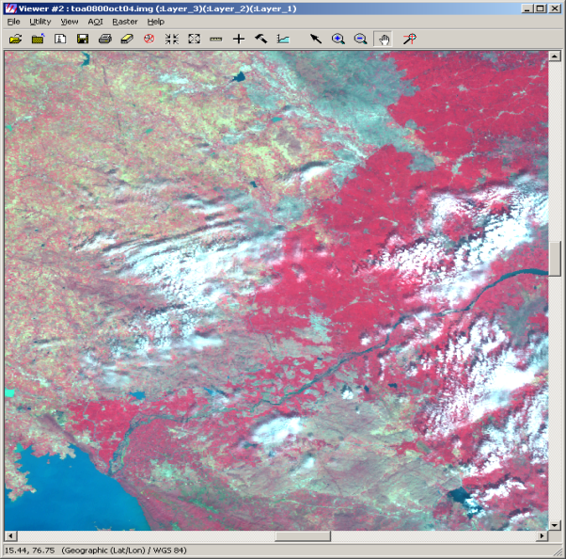
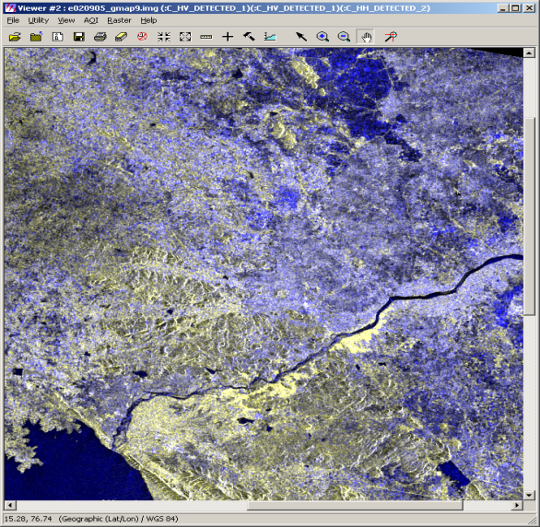
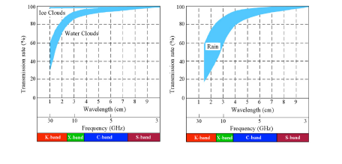
Why- IMAGING UNDER CLOUDY CONDITION
Data consistency
Temporal data

Slide 22
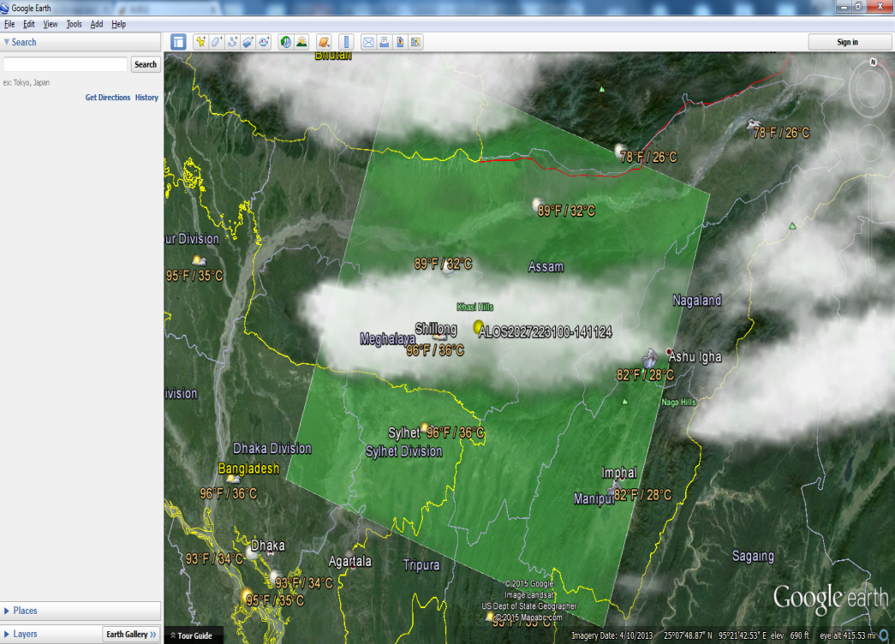
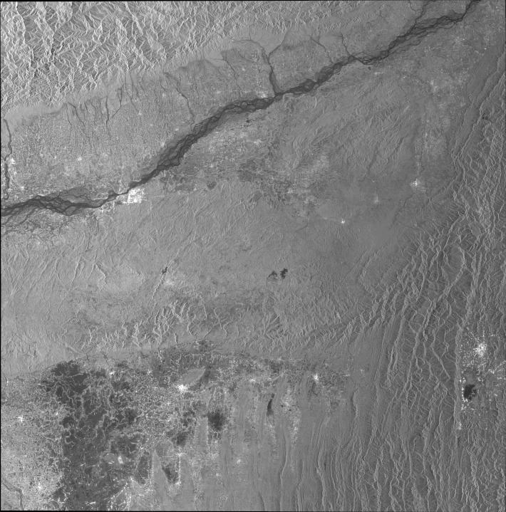
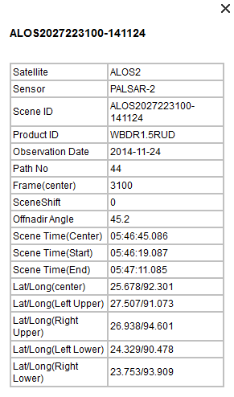

Penetration:
24-11-2014
Helps in long term data set

Slide 23
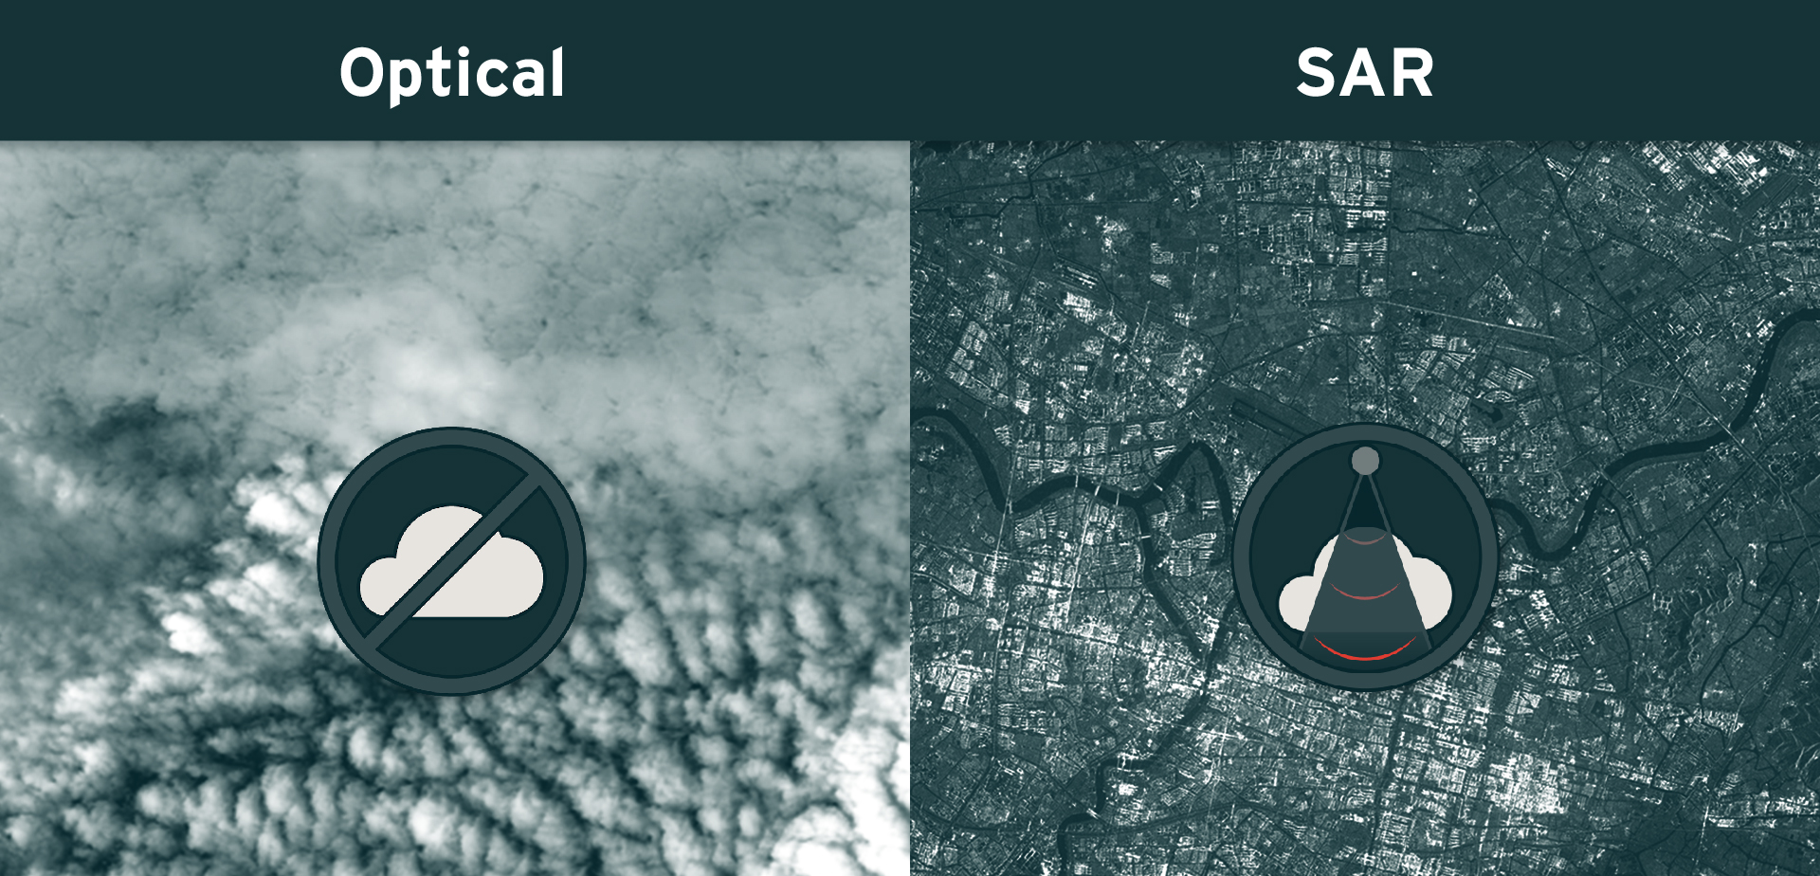

Slide 24
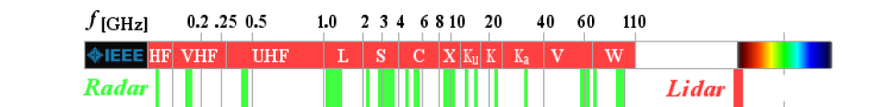
Penetration capability;
Thin sheet
Ice layer

Slide 25
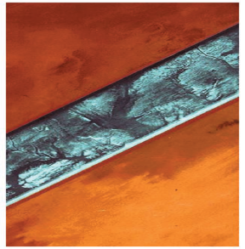
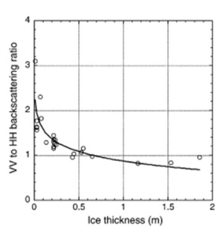

Slide 26
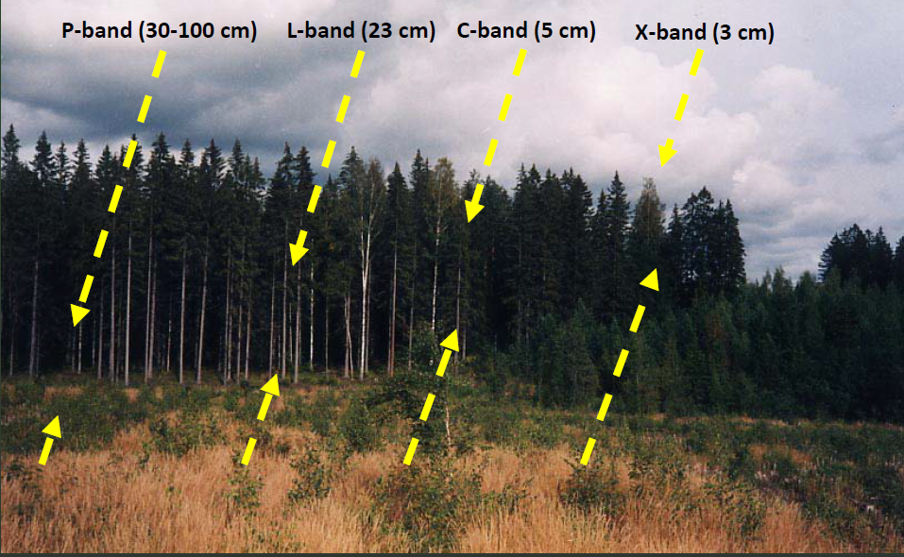
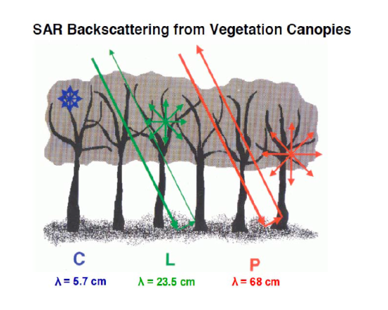
INTERACTION WITH DIFFERENT PART OF VEGETATION
Penetration depth: (Lemda*sqrt( E’))/(2*Pi*E”)

Slide 27
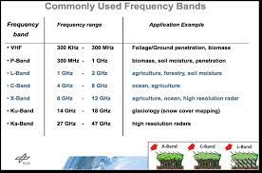

Slide 28
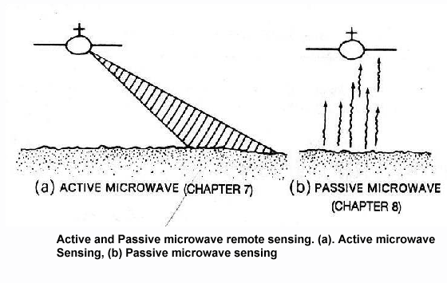
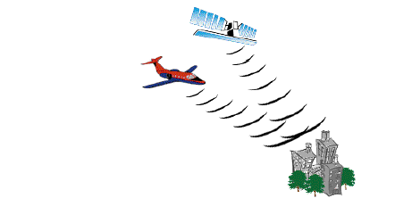

Bistatic
Monostatic
ACTIVE => RADAR* ( SLAR/SAR, SCATTEROMETER, ALTIMETER)
PASSIVE=> RADIOMETER
ACTIVE- MODE OF OPERATION: BISTATIC MODE, MONOSTATIC MODE
TODAYS CONTEXT: MONOSTATIC MODE ONLY
*Acronym: RAdio Detection And Ranging

Slide 29


Slide 30
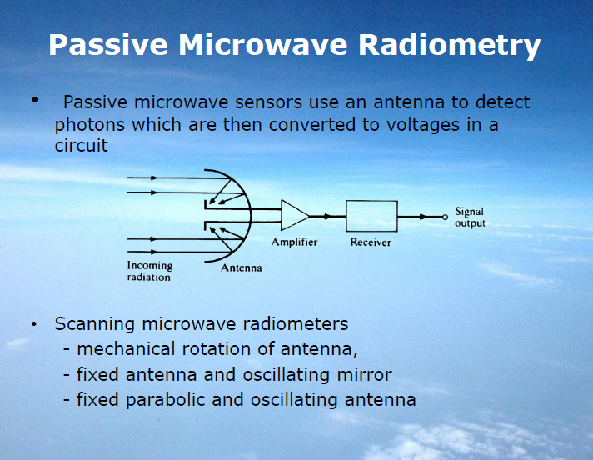

Slide 31
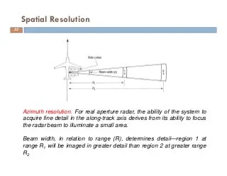

Slide 32
The most common form of imaging active microwave sensors is RADAR
Non-imaging microwave sensors include
Altimeters and scatterometers.
imaging radars (side-looking) used to acquire images (~1m - 1km)
altimeters (nadir-looking) to derive surface height variations
scatterometers to derive reflectivity as a function of incident angle, illumination direction, polarisation, etc
http://ecoursesonline.iasri.res.in/mod/page/view.php?id=124951

Slide 33
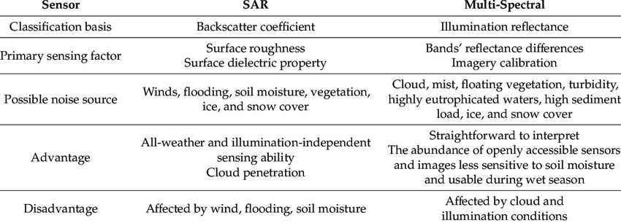

Slide 34
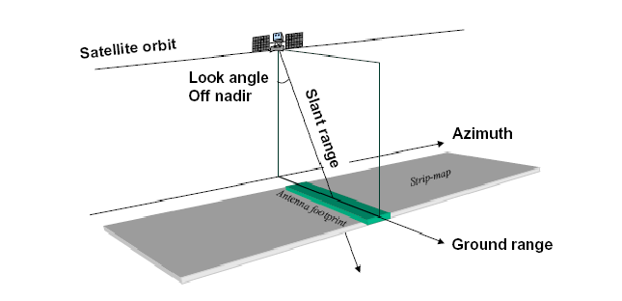
https://crisp.nus.edu.sg/~research/tutorial/mw.htm

Slide 35
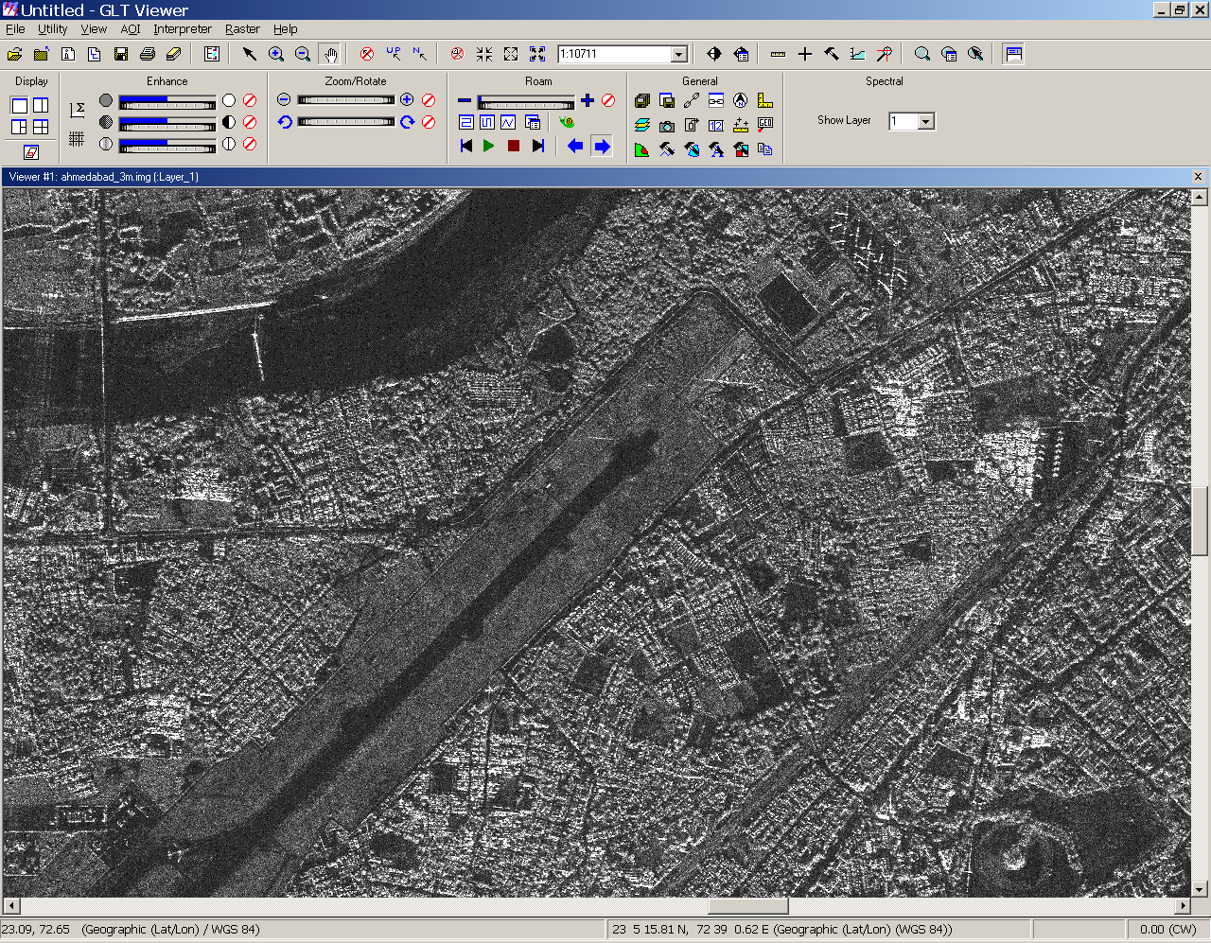

Response to surface material properties
Sliced image map of ERS-2,
C – band Sigma-0 at 40º of incidence angle.

Slide 36
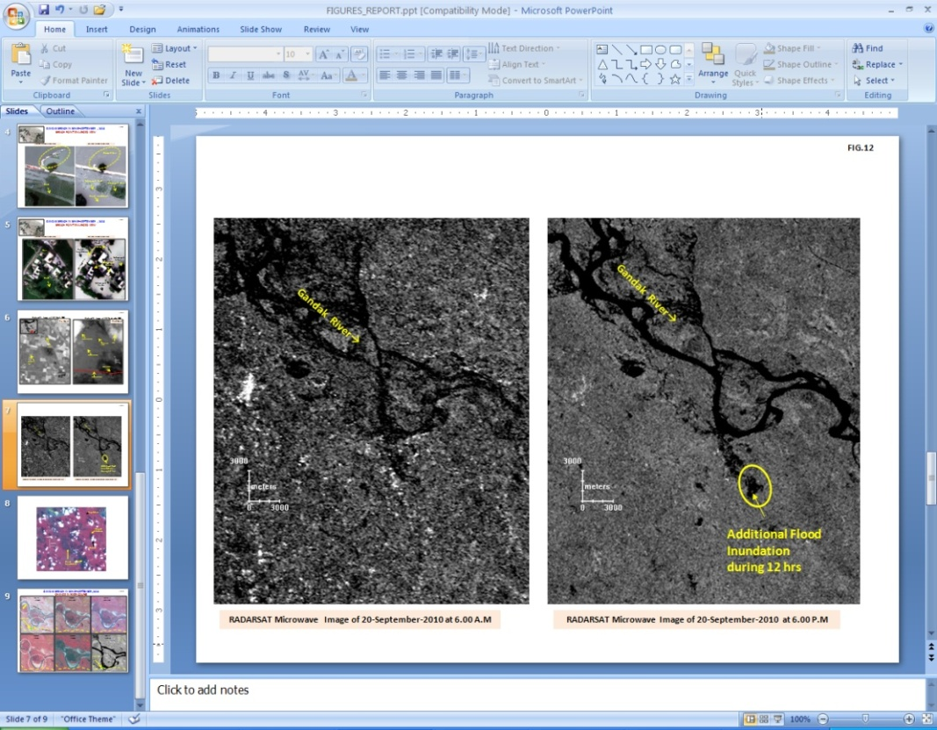
Morning
Evening
North Bihar: Gopal ganj – 20-9-2010

Slide 37
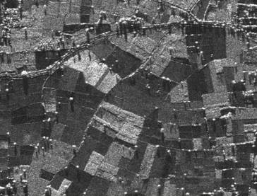
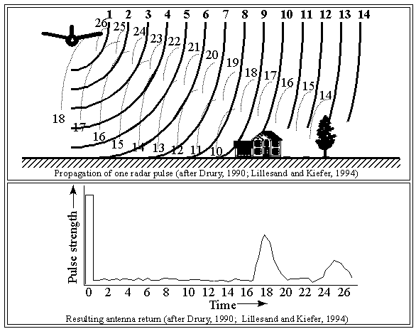
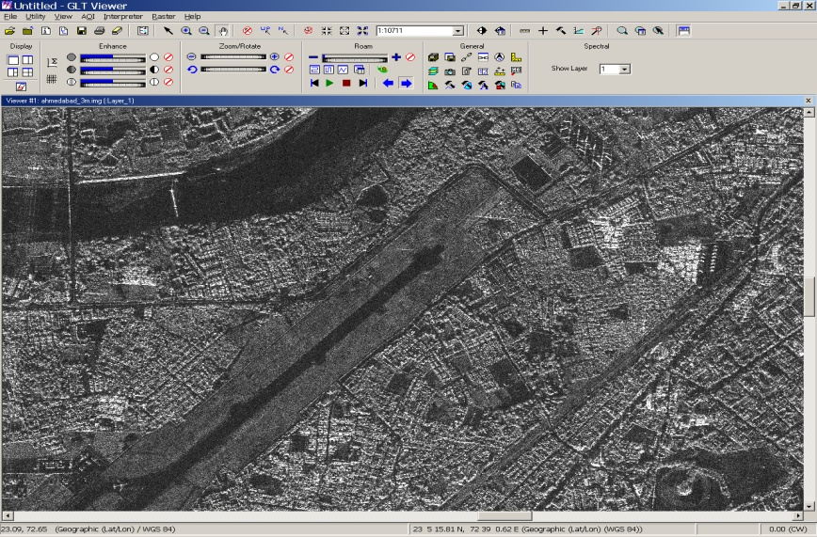
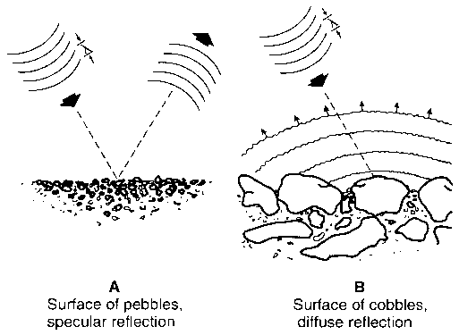
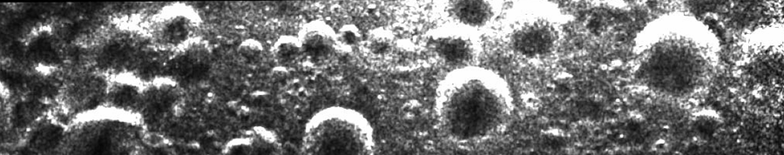
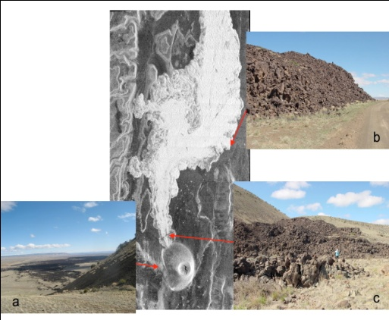
Connect to Industry
Connect to Global Experts
Knowledge dissemination
Virtual laboratory
Participation in International Program
Members benefit

Slide 38
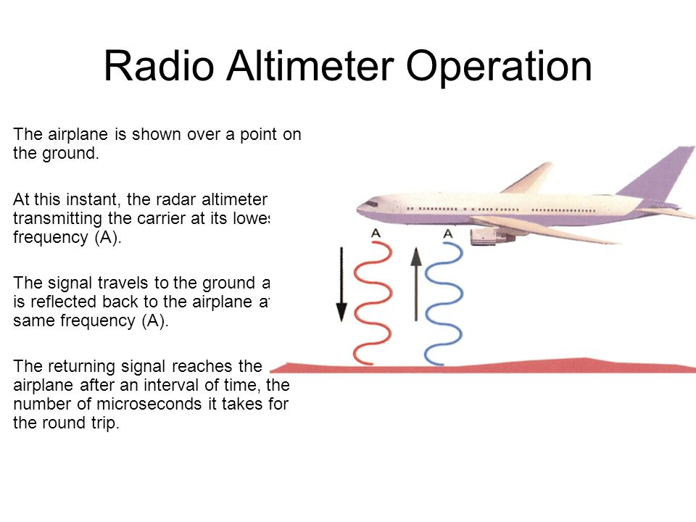
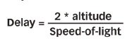

Slide 39
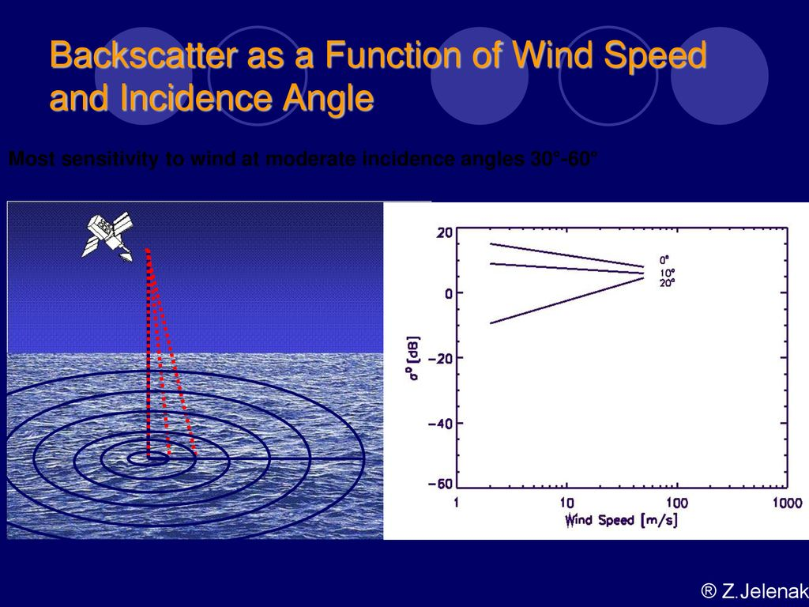
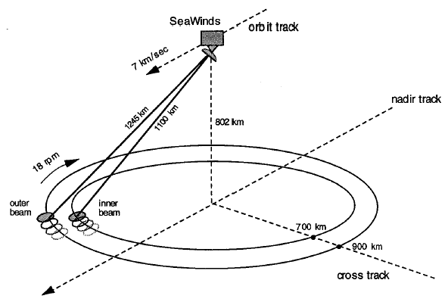
A scatterometer is a microwave radar sensor used to measure the reflection or scattering effect produced while scanning the surface of the earth from an aircraft or a satellite.

Slide 40
Agriculture. Differences in surface roughness are indicative of field ploughing, soil tillage, and crop harvesting.
Floods. ...
Land subsidence. ...
Snow cover. ...
Wildfires. ...
Wetlands.
MAJOR ADVANTAGE: PENERATION THROUGH CLOUDS

Slide 41
Question bank
Explain working principle of Lidar
What are advantages of Thermal remote sensing
What are advantages of microwave remote sensing

